Slide 1
Inheriting Alleles and Punnett Squares

Slide 2
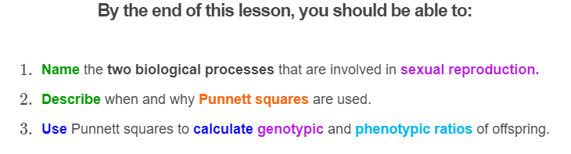
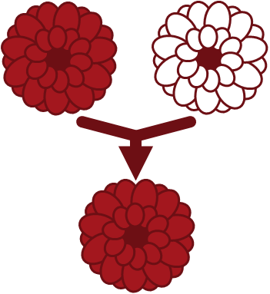

Slide 3
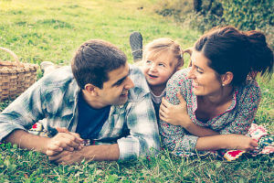
Have you ever wondered what your kids will look like?
Will they have the same eye colour as you? Will they be the same height? Or maybe they will look more like your partner.

Slide 4

To make these predictions, we need to understand how alleles are passed from one generation to the next.
This involves two important processes: meiosis and fertilization.
We are going to explore these processes using Susan and her partner Ruben, who are starting a family.

Slide 5
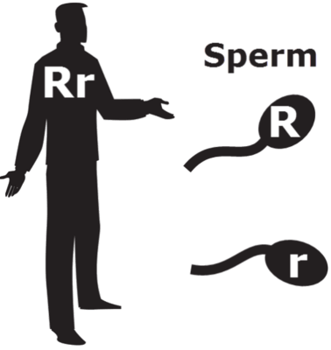
Meiosis is a type of cell division that makes gametes (sperm and eggs).
Because gametes are haploid, they can carry only one allele per gene.
Remember, humans have two alleles for each gene. Gametes can only have one, so half of the gametes get one allele and half get the other allele.

Slide 6
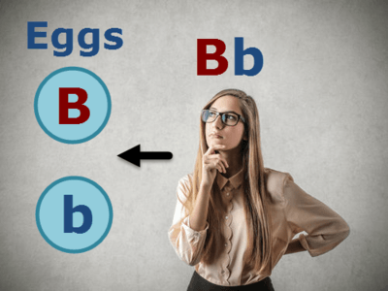
Let's use Susan’s alleles as an example.
In humans, there is a gene which controls eye colour. Susan has the alleles Bb, where the B allele codes for brown eyes and the b allele for blue eyes.
During meiosis, half of Susan's eggs receive the allele for brown eyes. The other half receive the allele for blue eyes.

Slide 7
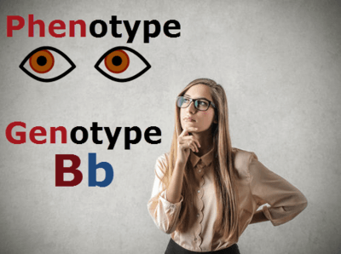
Remember, Susan’s alleles (Bb) make up her genotype.
They result in a certain trait, called her phenotype.
In this case, Susan has brown eyes. This is because the allele that codes for brown eyes is dominant over the allele that codes for blue eyes.

Slide 8
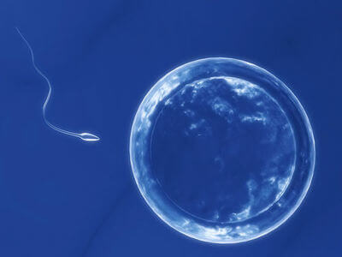
The second part of reproduction is fertilization.
This is when one egg fuses with one sperm to make a single cell called a zygote. The zygote then grows into a baby.
Fertilization is important because it combines the mother’s and the father’s DNA! The alleles in the sperm and egg combine to make up the genotype of the offspring.

Slide 9
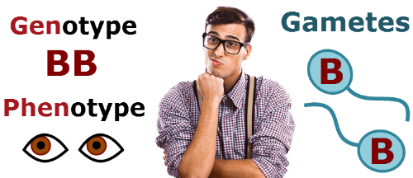
Now, let’s review what we have learned so far by looking at Ruben.
Ruben has the genotype BB (he has two copies of the allele coding for brown eyes). Having brown eyes is his phenotype.
Each of Ruben’s gametes will have one of his alleles as a result of meiosis. All of Ruben’s gametes will have an allele for brown eyes because that is all he has to pass on to them.
One of Ruben’s gametes will fuse with one of Susan’s gametes during fertilization, combining one of his alleles for eye colour with one of her alleles.

Slide 10

So now we know what Ruben and Susan’s gametes look like.
But what about their offspring? This is where the Punnett square comes in!
Punnett squares are used to show all of the possible genotypes that the offspring could have and determine how likely each genotype is to occur.

Slide 11
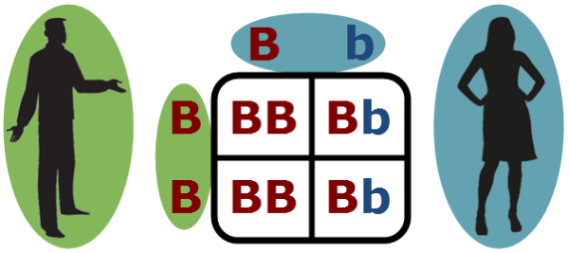
Here is the Punnett square for Ruben and Susan.
On top of the square are Susan’s alleles B and b. These represent her gametes! Remember, as a result of meiosis, half of Susan’s eggs have the allele for brown eyes (B) and half have the allele for blue eyes (b).
On the left of the square are Ruben’s gametes B and B. All of his gametes have one allele for brown eyes.

Slide 12
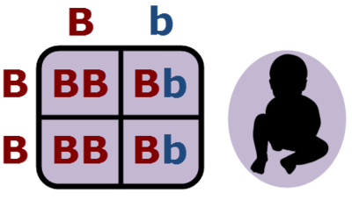
In the centre of the Punnett square are the results of fertilization.
Each of the four boxes has two alleles, one of which comes from a sperm and one from an egg. These show the different allele combinations that Ruben’s sperm and Susan’s eggs can make.
In other words, these are Ruben and Susan's possible children.

Slide 13
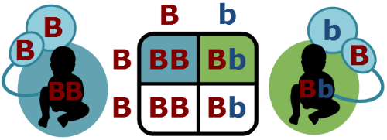
Punnett squares show the possible genotypes of offspring.
For example, in the top left box, a sperm with the allele for brown eyes (B) fertilized an egg with the allele for brown eyes (B) to make the allele combination BB.
In the top right, a sperm with the allele for brown eyes (B) fertilized an egg with the allele for blue eyes (b) to make the allele combination Bb.

Slide 14
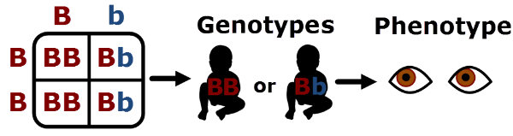
This Punnett square shows us that Susan and Ruben's children can have either the genotype BB or Bb.
Both of these genotypes result in brown eyes. So Susan and Ruben can only have children with the brown eye phenotype!
As you can see, the Punnett square allows us to see all the possible children Susan and Ruben could have!

Slide 15
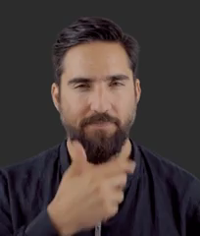
So we know that Susan and Ruben's child will have either the genotype Bb or BB.
But how likely is it for each genotype will occur?

Slide 16
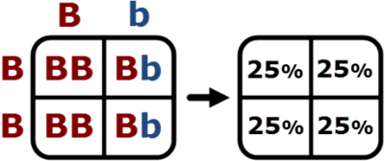
This is where Punnett squares are really useful!
Each of the four inner boxes has the same chance of happening. This means each box has a 25% chance of containing the genotype of Susan and Ruben's child.

Slide 17
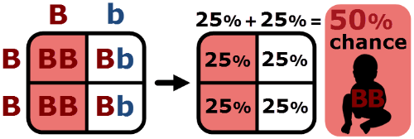
Notice that the genotype BB is present in two boxes.
You need to add the probabililty of both boxes together to find the overall probability that Susan and Ruben's child will have the genotype BB.
25%+25% is 50%, so their child has a 50% chance of inheriting the BB genotype.
To find the probability of the Bb genotype, do the same thing again.

Slide 18
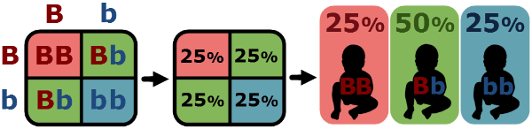
Here is a different Punnett square where both parents have the genotype Bb.
Here, the probability for a child to have the genotype BB is only 25%, because it occurs in only one of the four squares.
The probability for the genotype bb is also 25%.
The probability for the genotype Bb is 50% because it is present in two boxes.

Slide 19
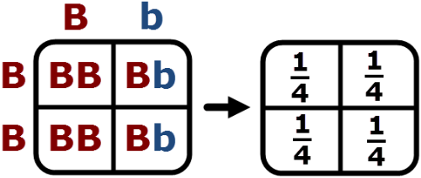
You can also use Punnett squares to figure out how many of Ruben and Susan's children will be have each genotype.
If Ruben and Susan had lots of children, each box would represent the genotype of one quarter of their children.

Slide 20
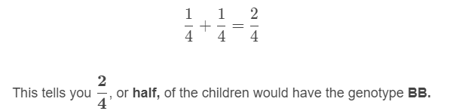
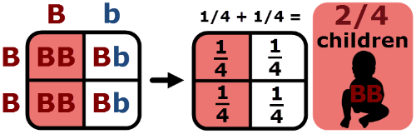
In the Punnet square below, the two possible genotypes are BB and Bb.
The genotype BB is present in two boxes. Just as you would when calculating probabilities, you need to add the boxes together to get the total proportion of offspring with the genotype BB.
You then do the same for genotype Bb.

Slide 21
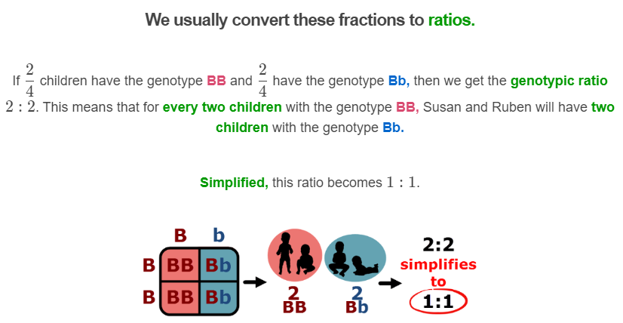

Slide 22
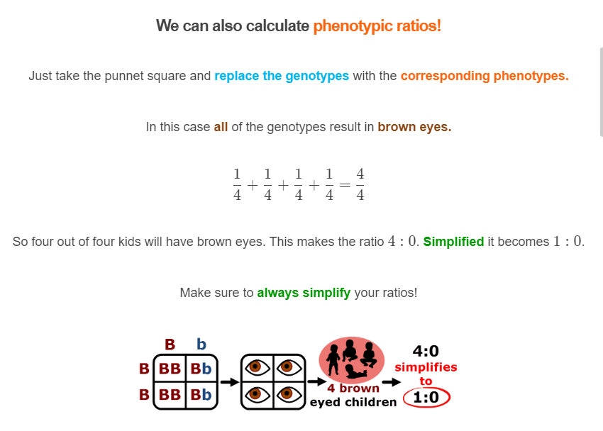

Slide 23
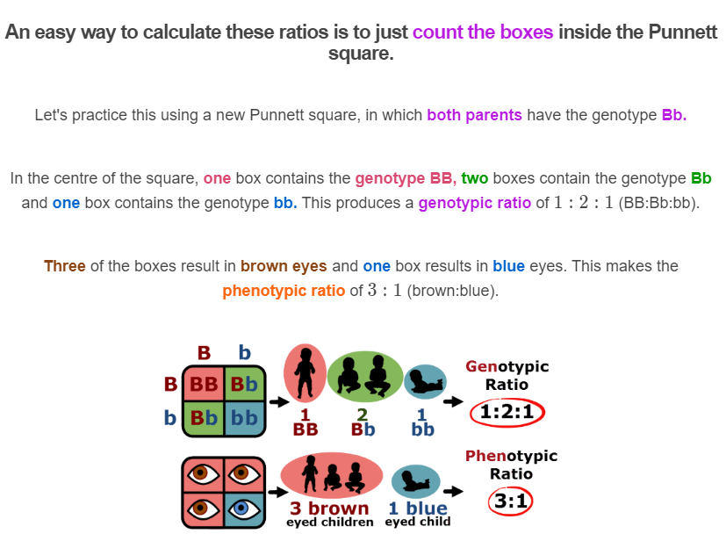

Slide 24
